Slide 1
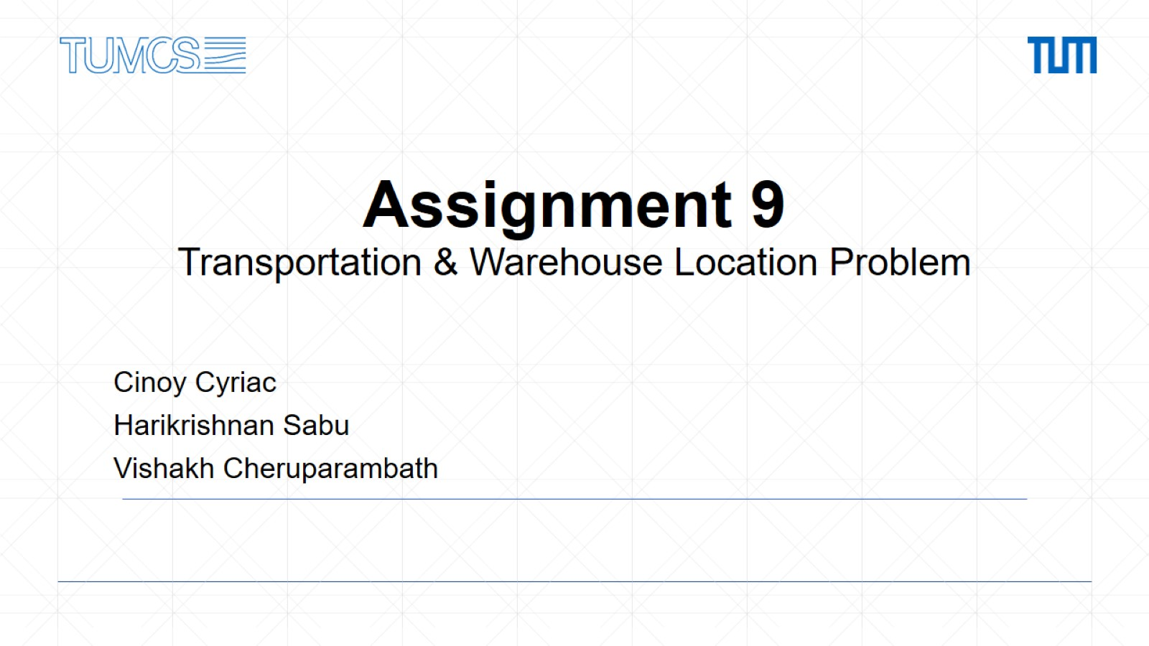
Assignment 9 Transportation & Warehouse Location Problem

Slide 2
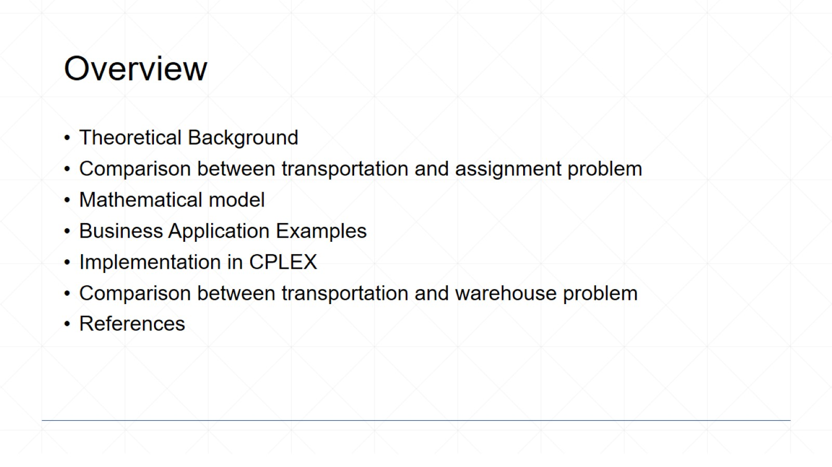
Overview

Slide 3
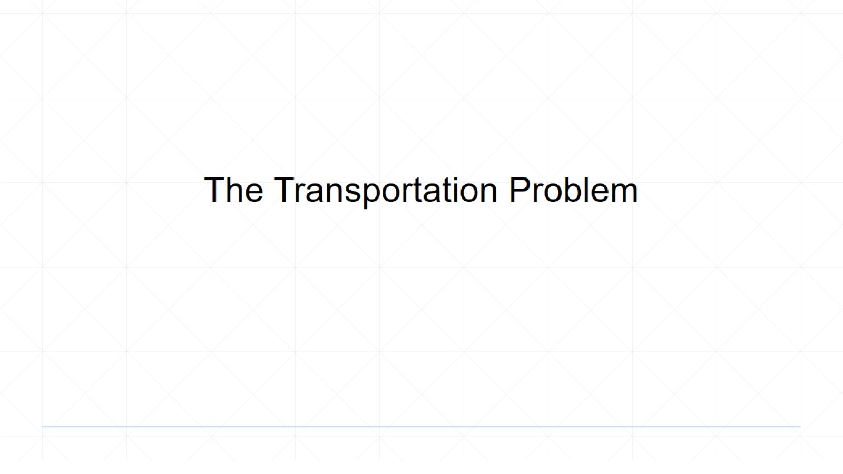
The Transportation Problem

Slide 4
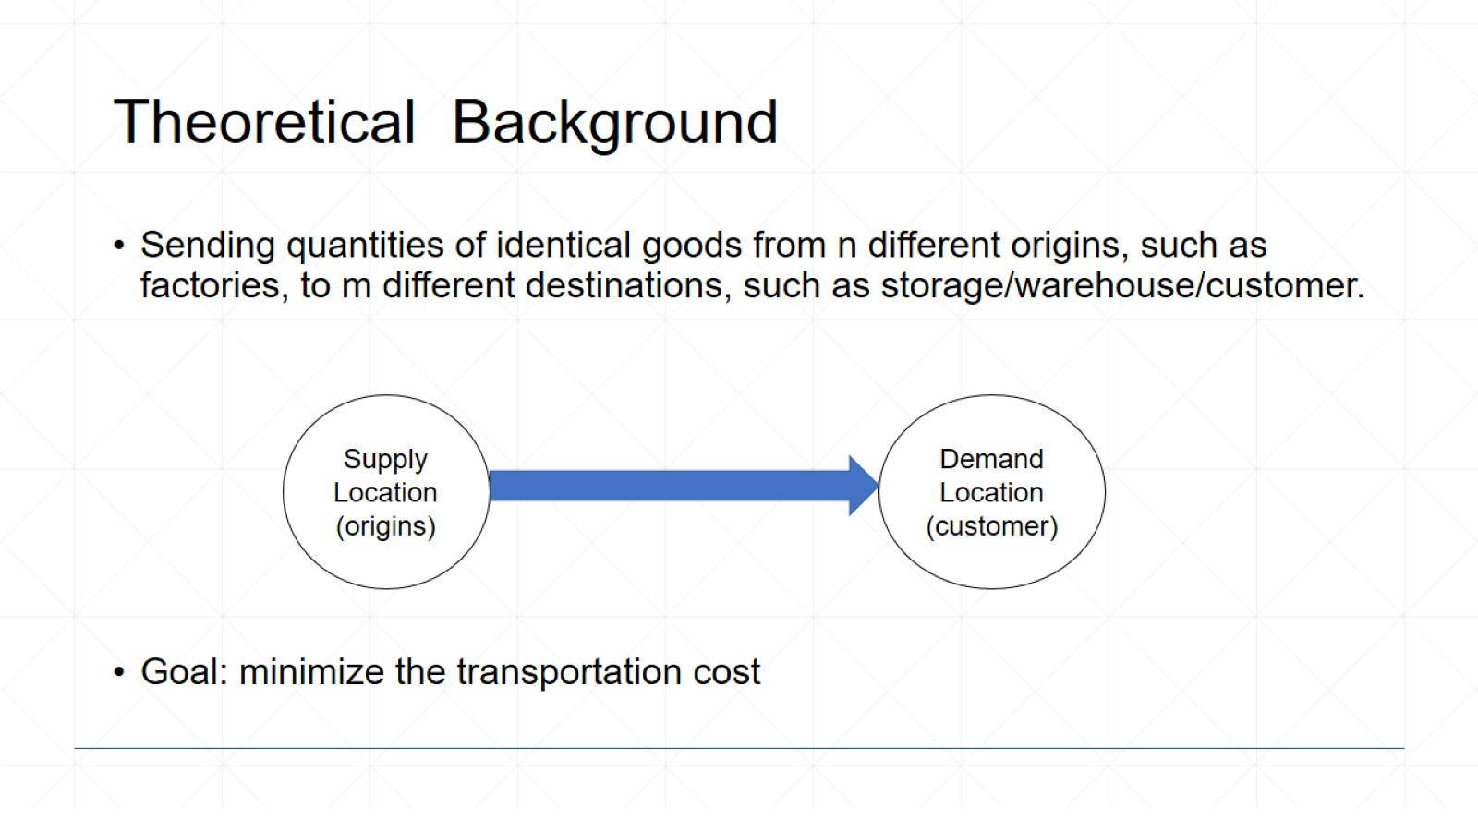
Theoretical Background

Slide 5
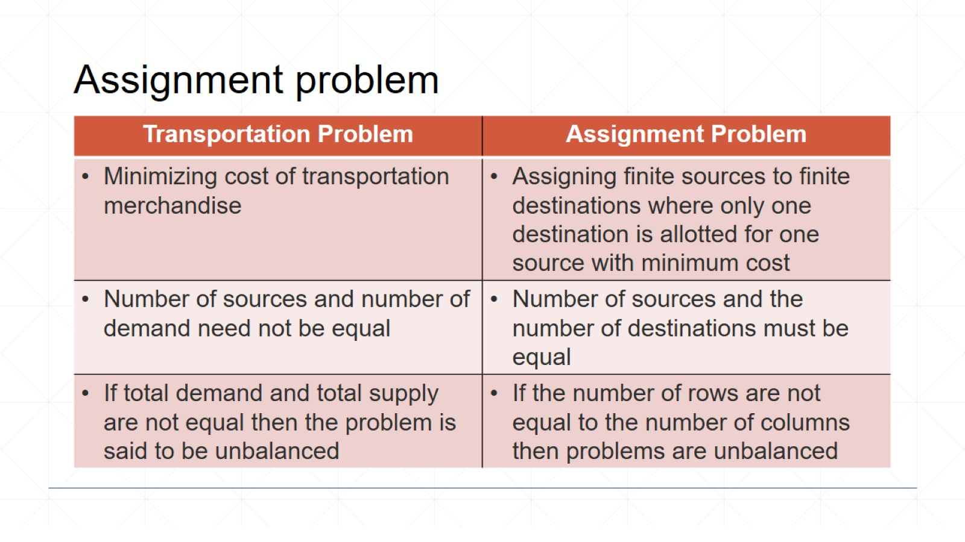
Assignment problem

Slide 6
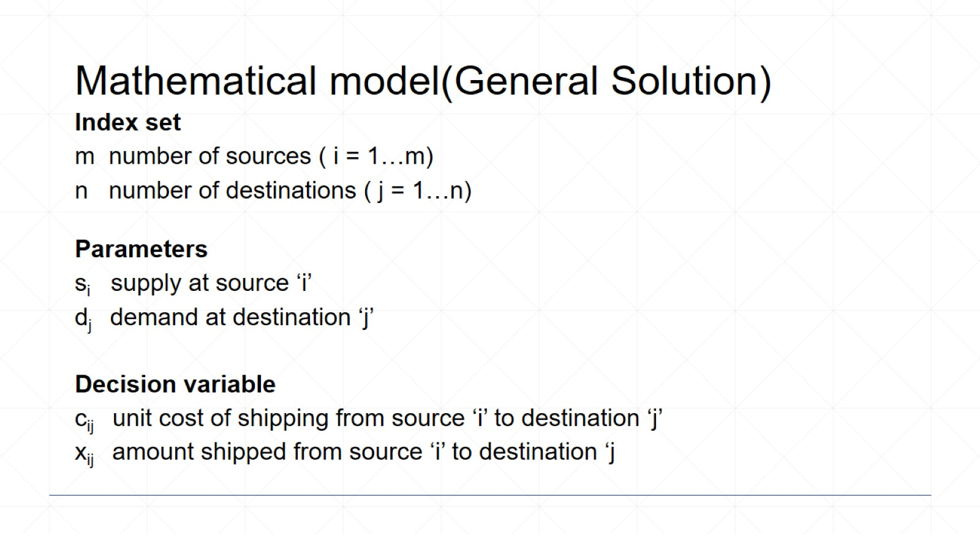
Mathematical model(General Solution)

Slide 7
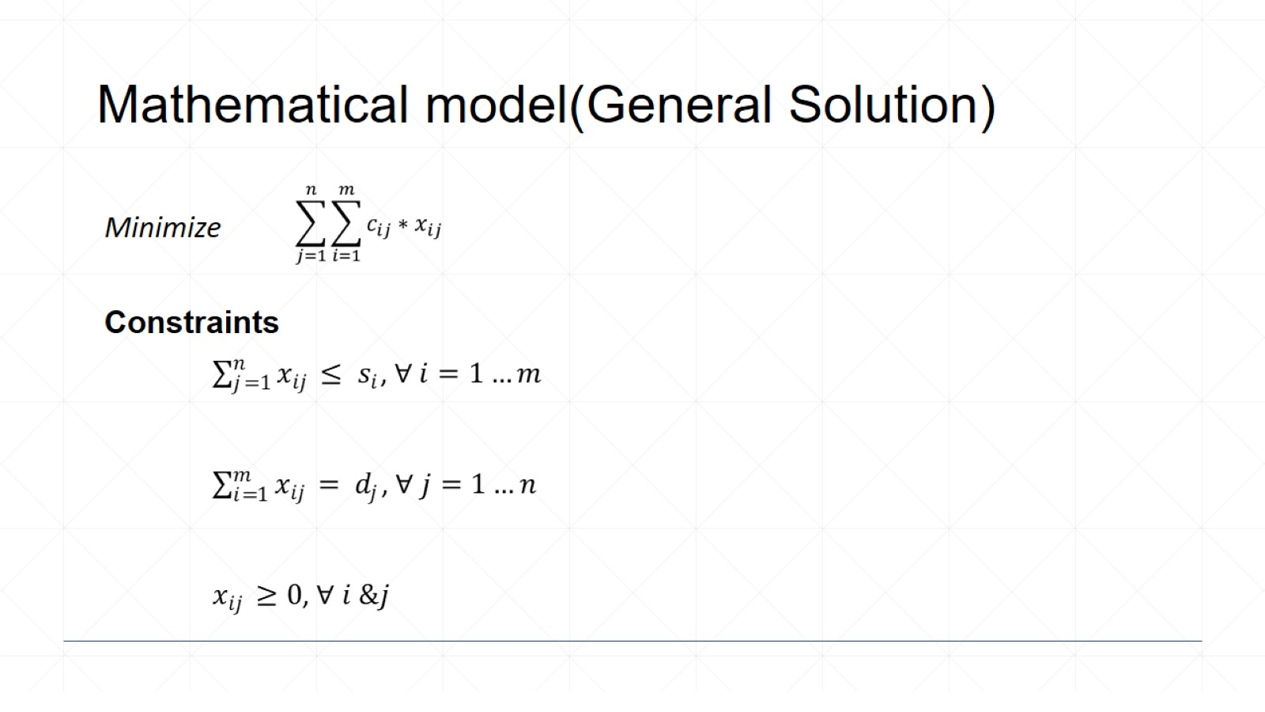
Mathematical model(General Solution)

Slide 8
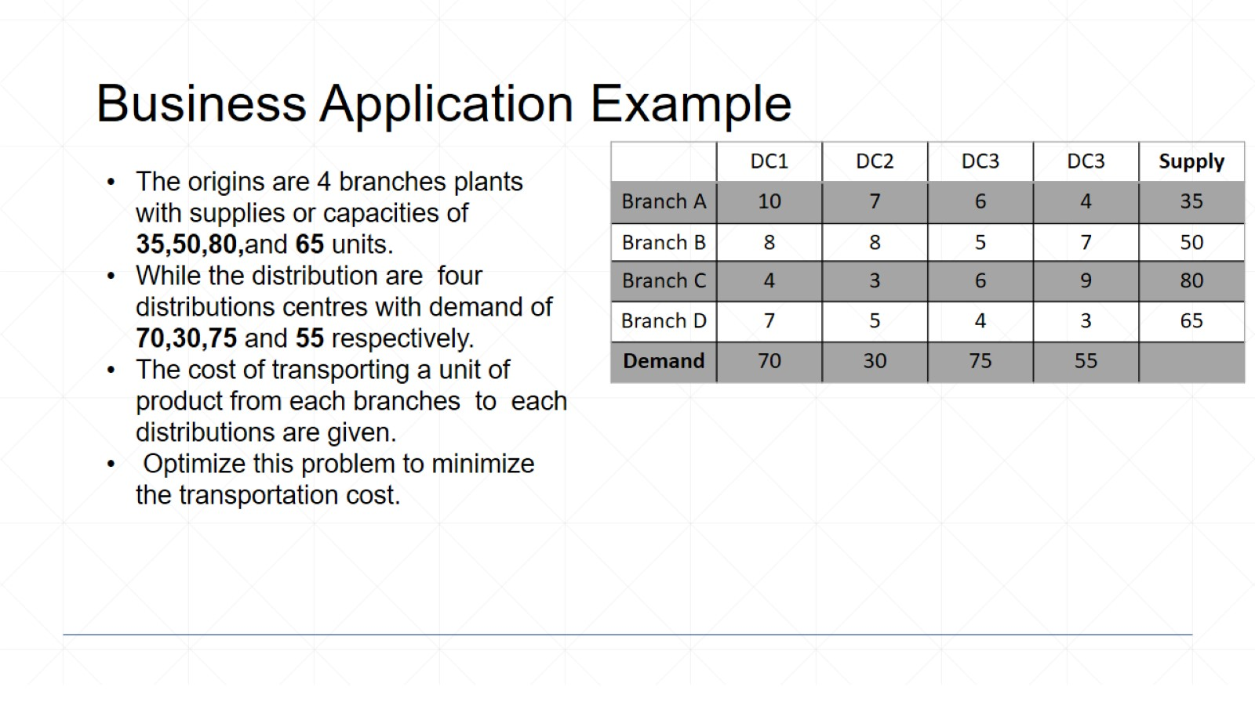
Business Application Example

Slide 9
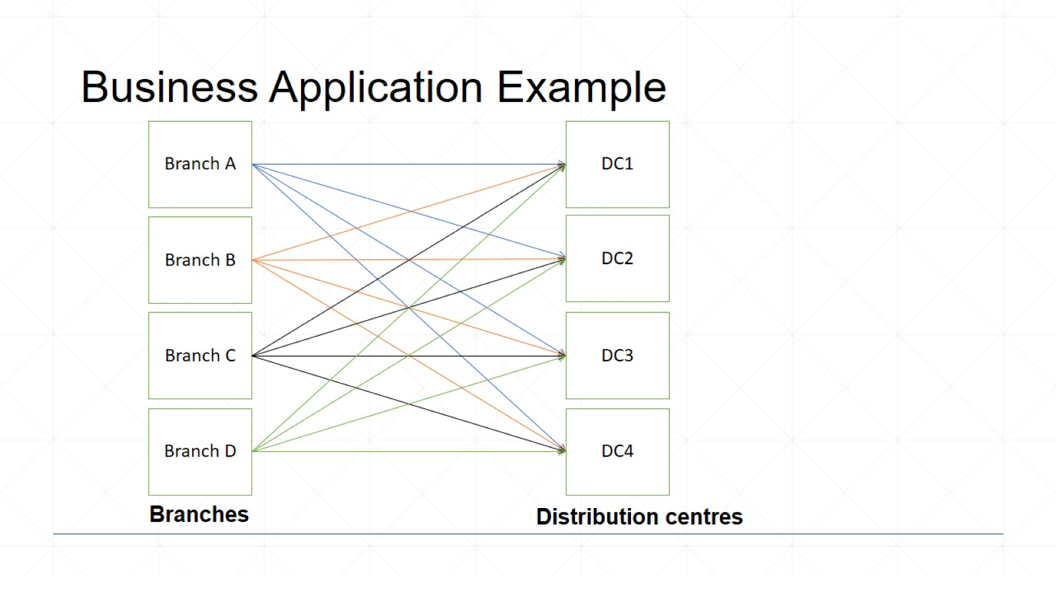
Business Application Example

Slide 10
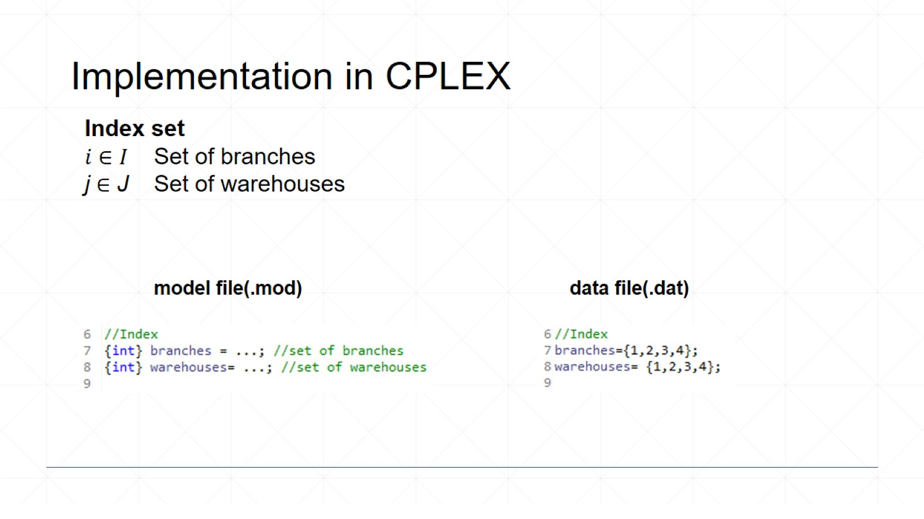
Implementation in CPLEX

Slide 11
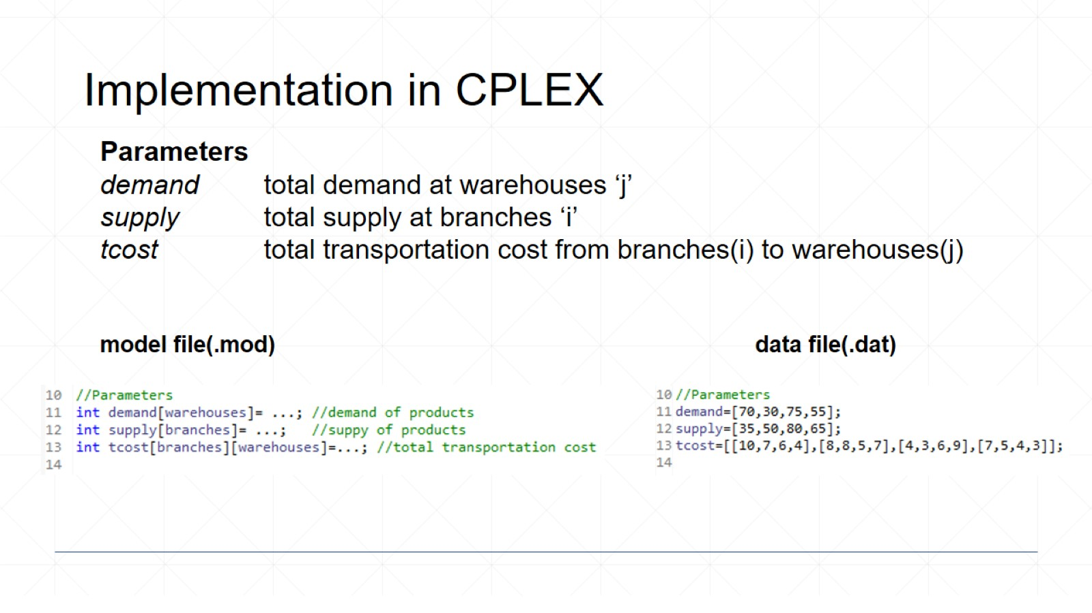
Implementation in CPLEX

Slide 12
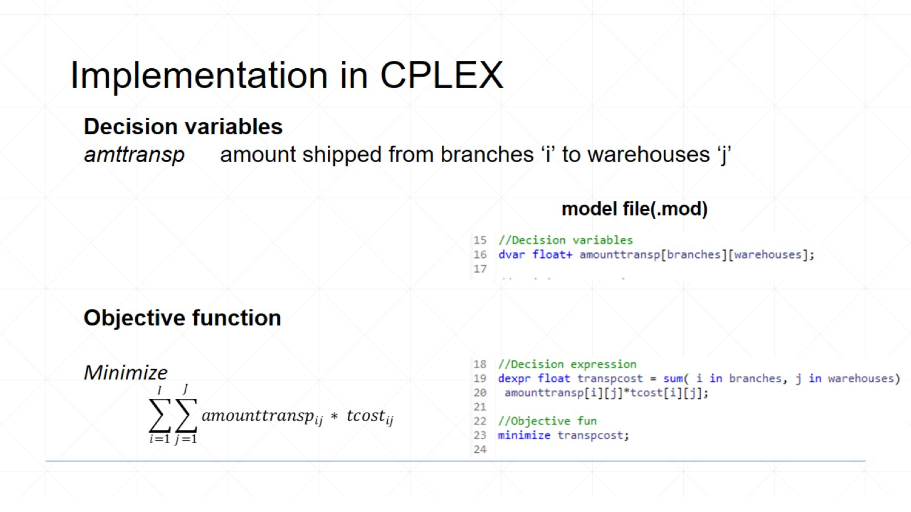
Implementation in CPLEX

Slide 13
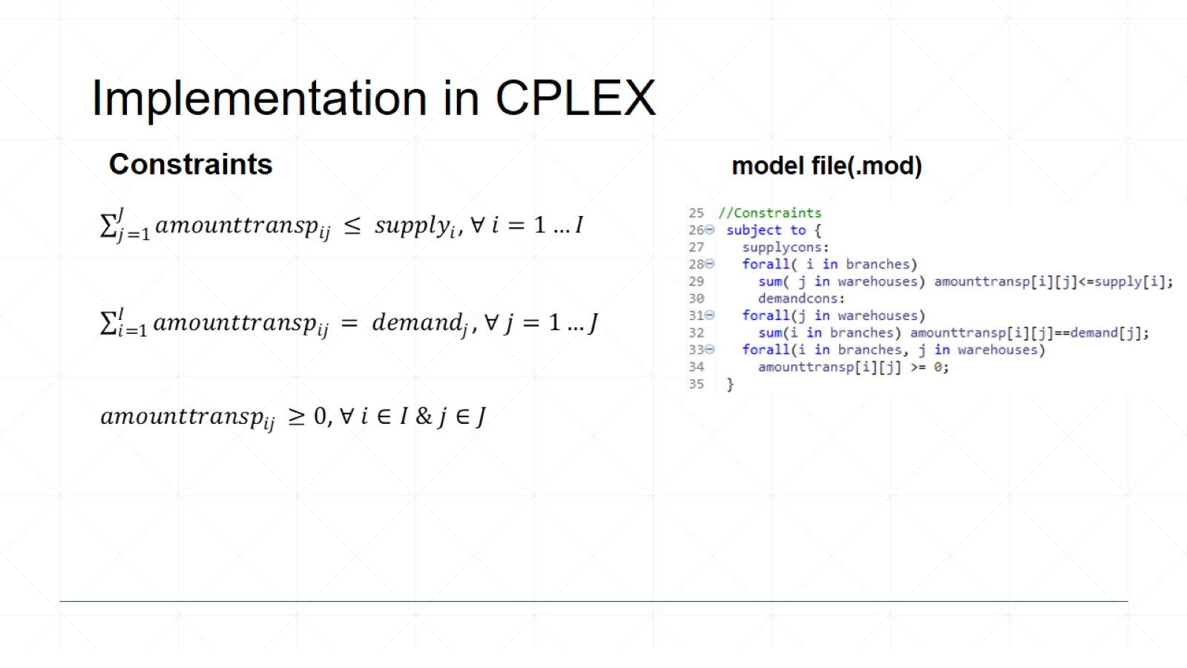
Implementation in CPLEX

Slide 14
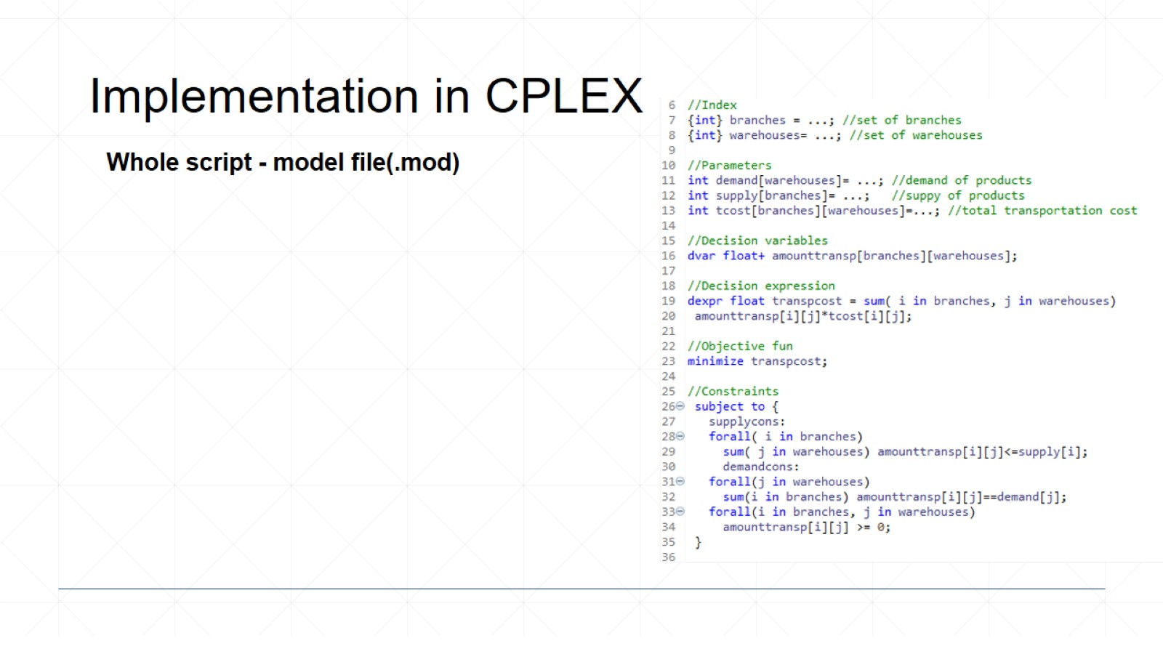
Implementation in CPLEX

Slide 15
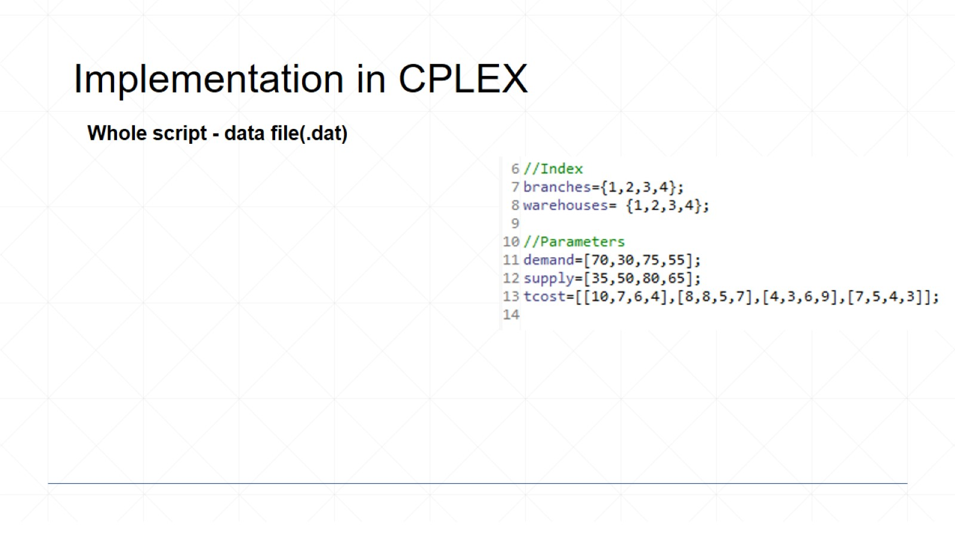
Implementation in CPLEX

Slide 16
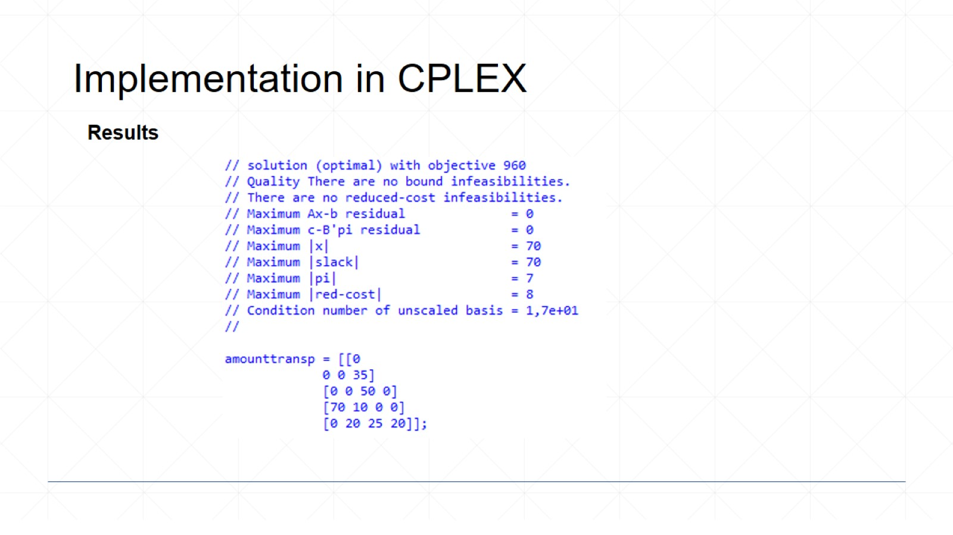
Implementation in CPLEX

Slide 17
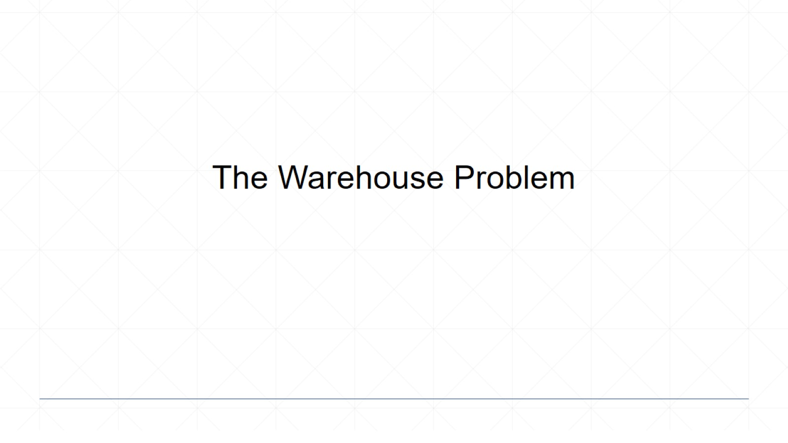
The Warehouse Problem

Slide 18
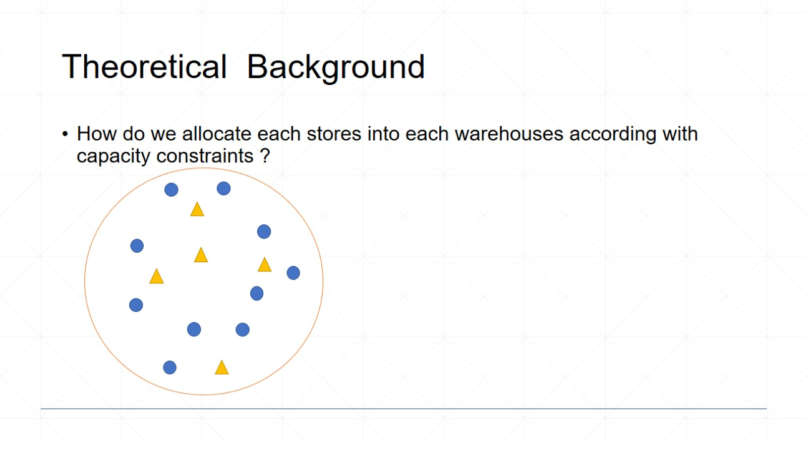
Theoretical Background

Slide 19
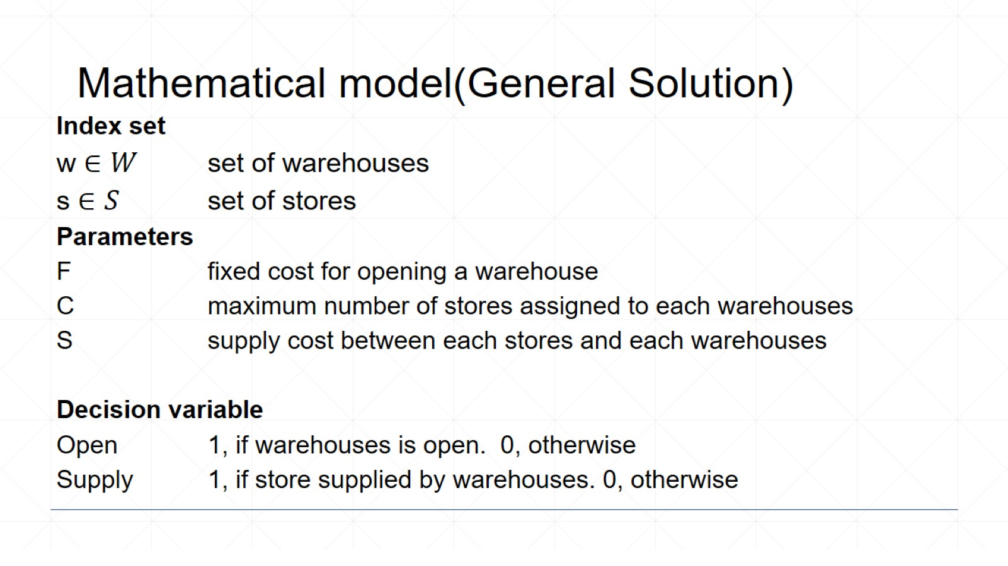
Mathematical model(General Solution)

Slide 20
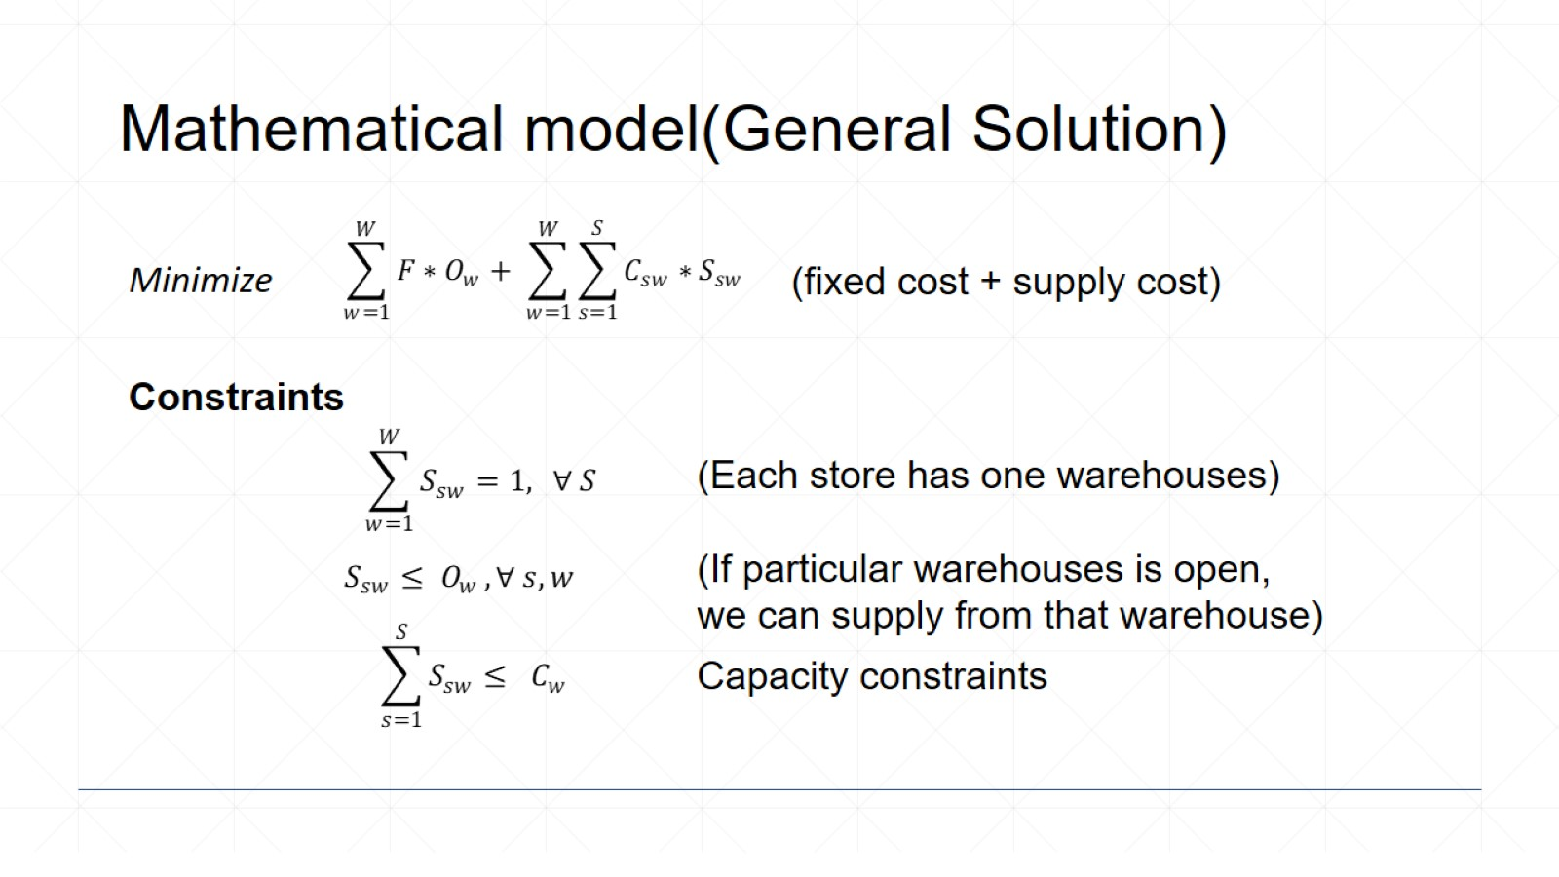
Mathematical model(General Solution)

Slide 21
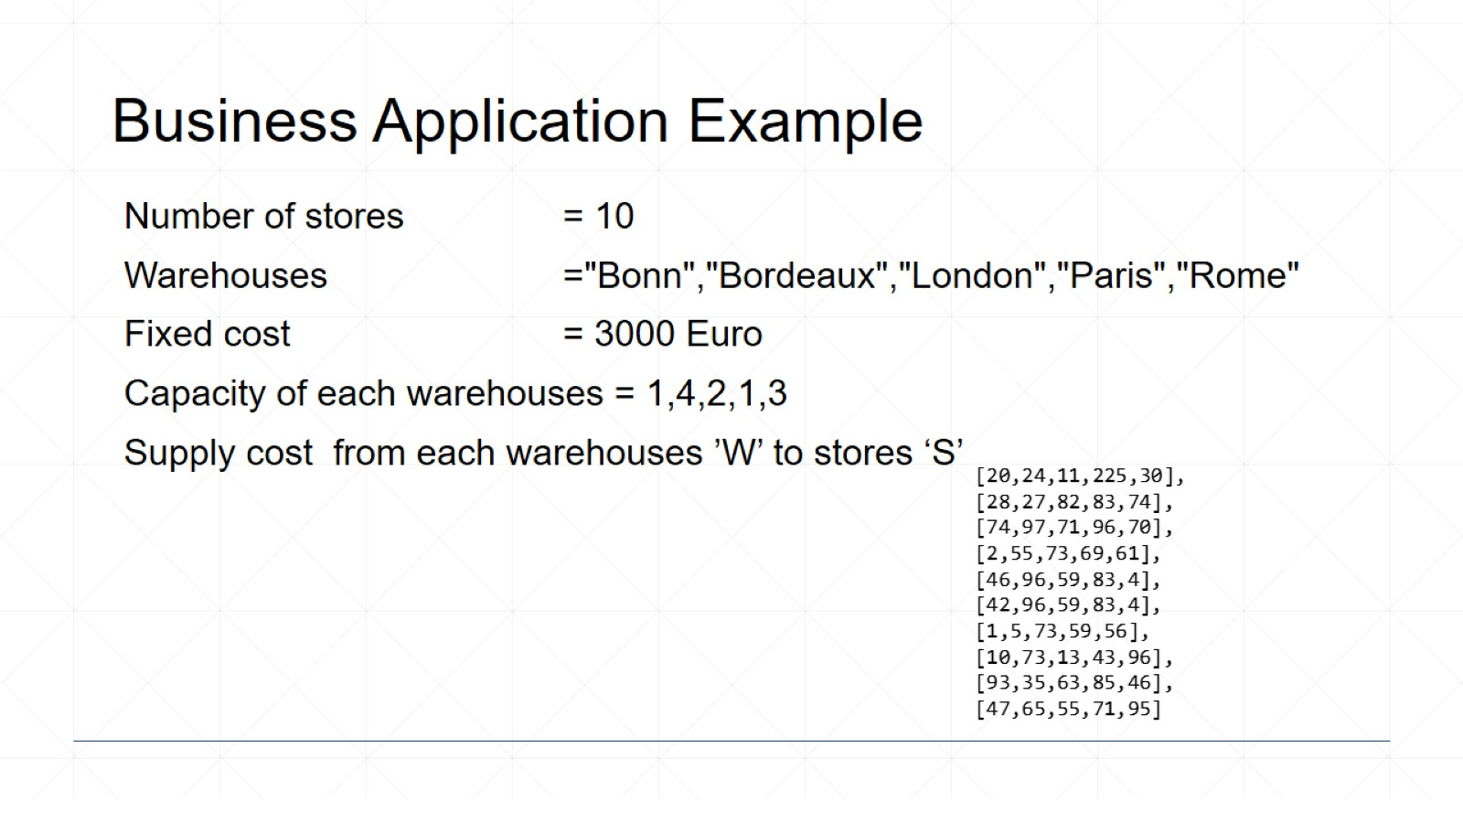
Business Application Example

Slide 22
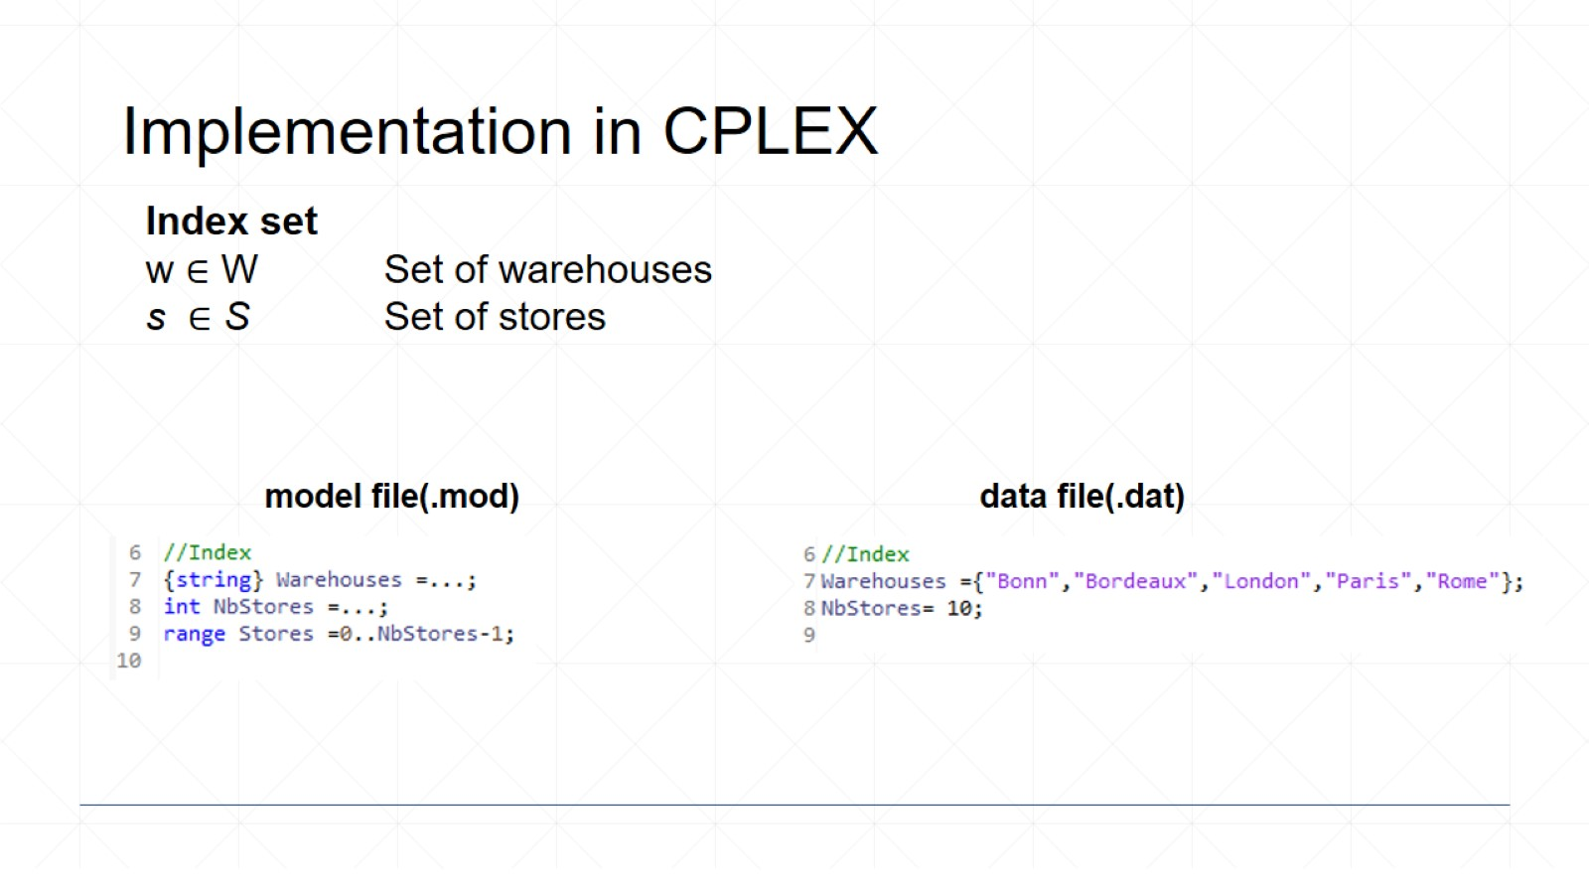
Implementation in CPLEX

Slide 23
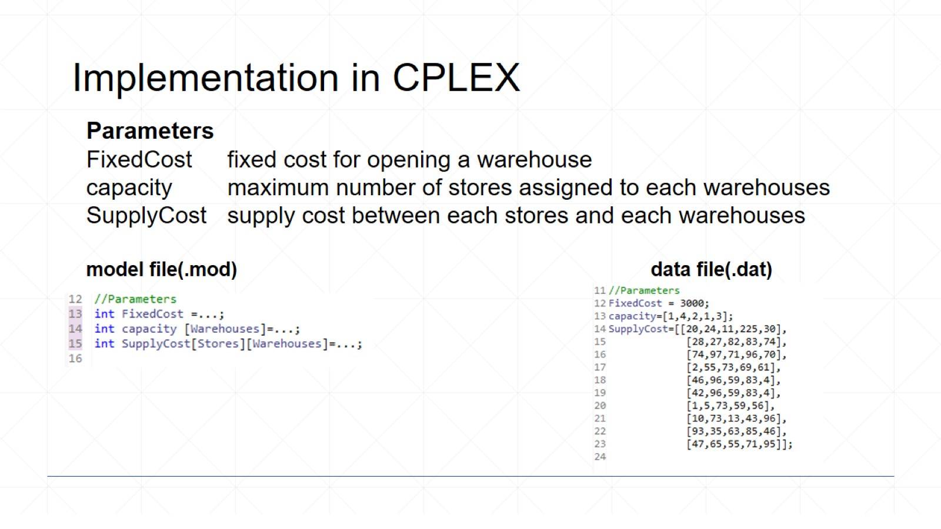
Implementation in CPLEX

Slide 24
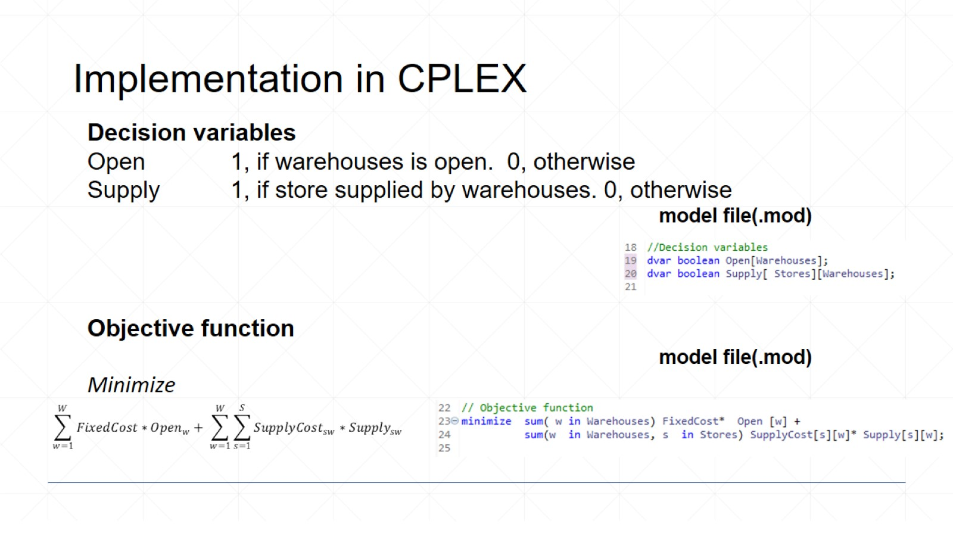
Implementation in CPLEX

Slide 25
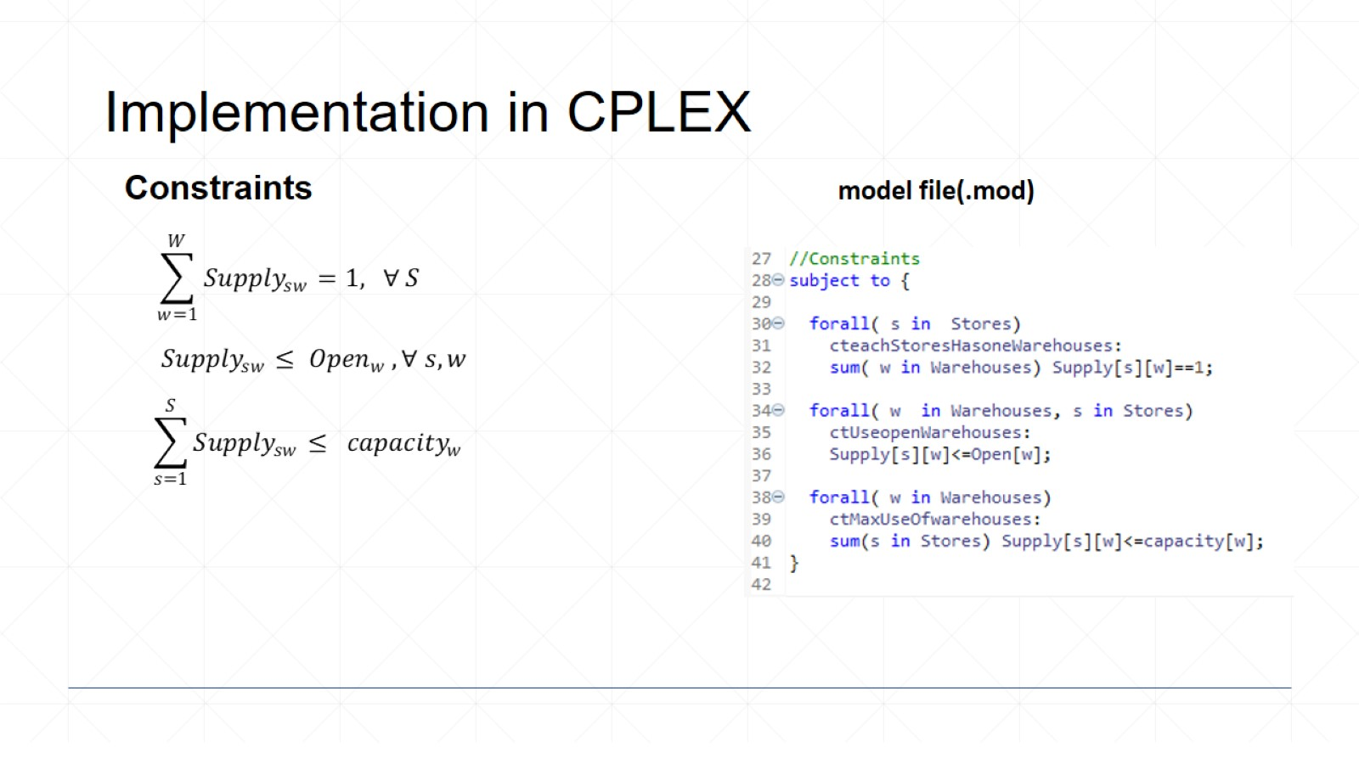
Implementation in CPLEX

Slide 26
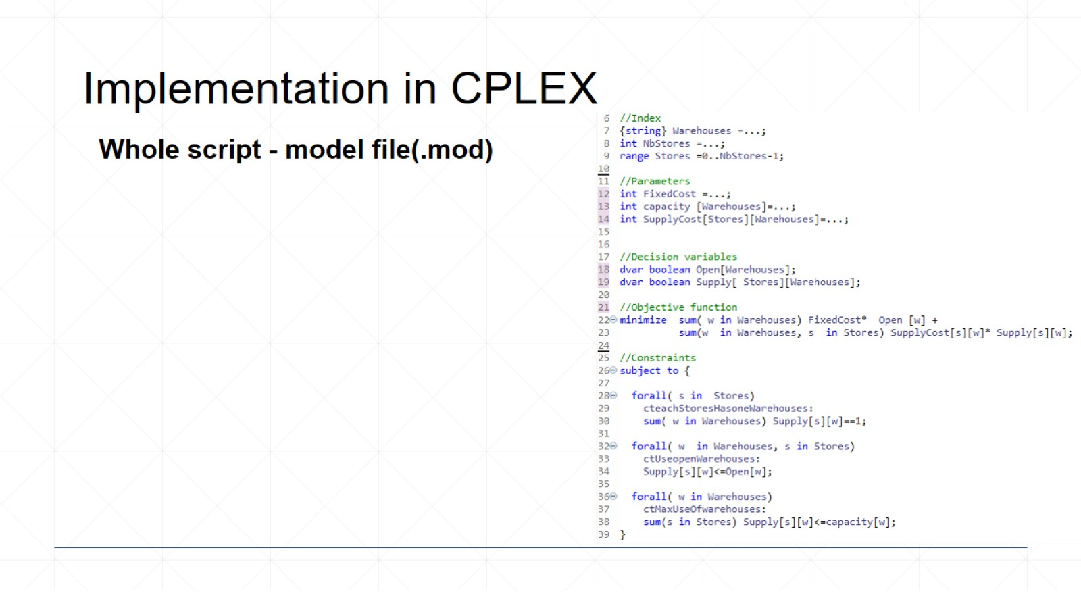
Implementation in CPLEX

Slide 27
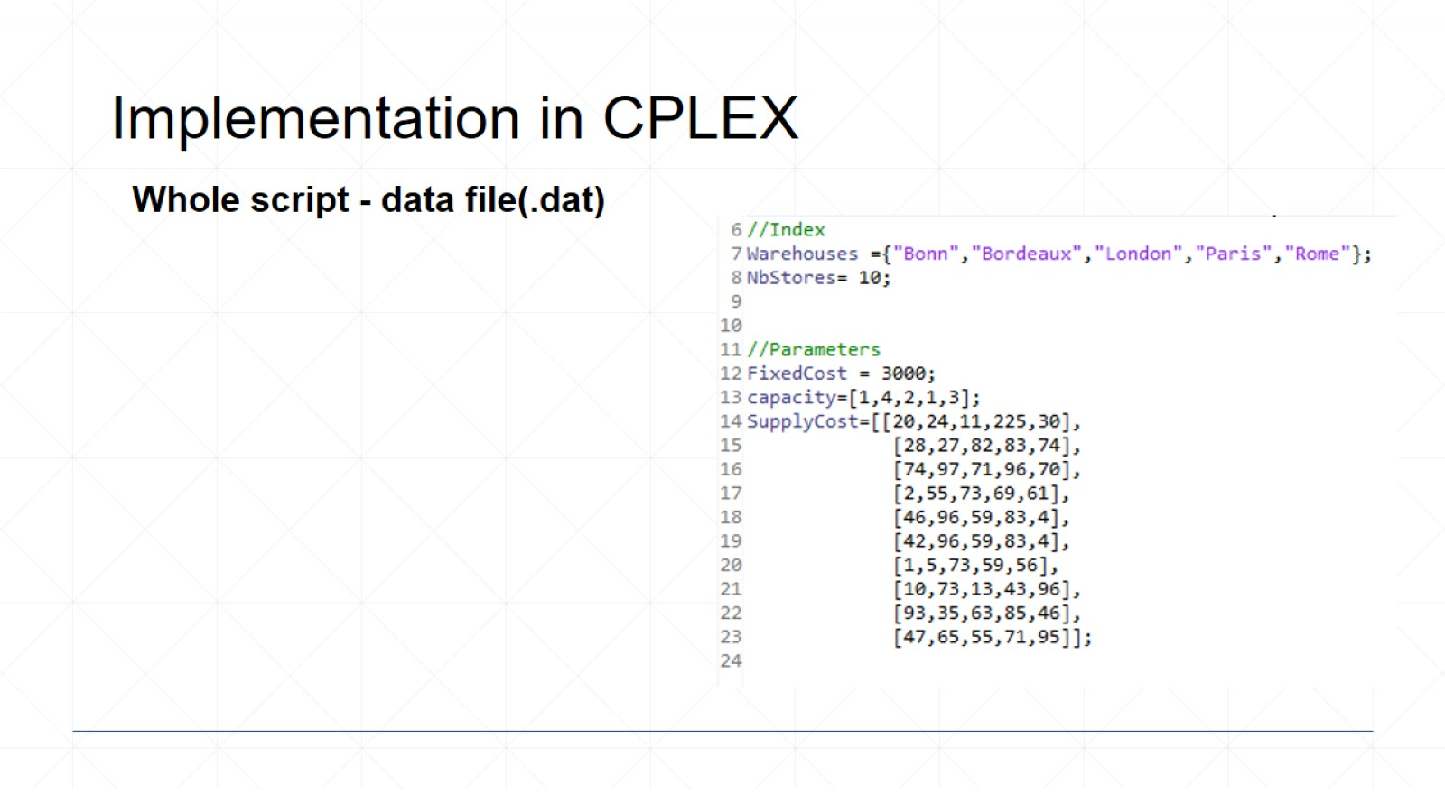
Implementation in CPLEX

Slide 28
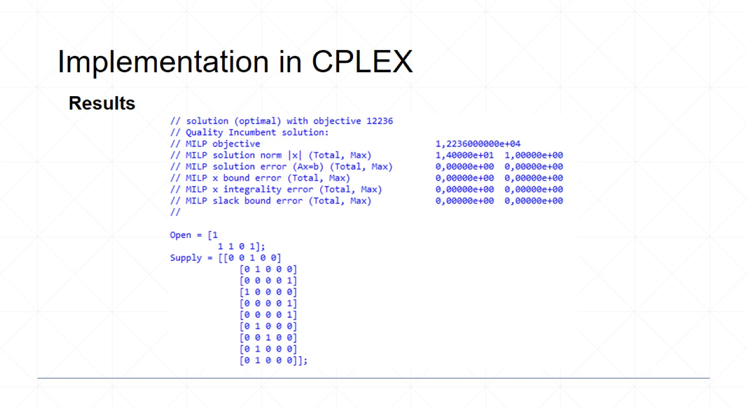
Implementation in CPLEX

Slide 29
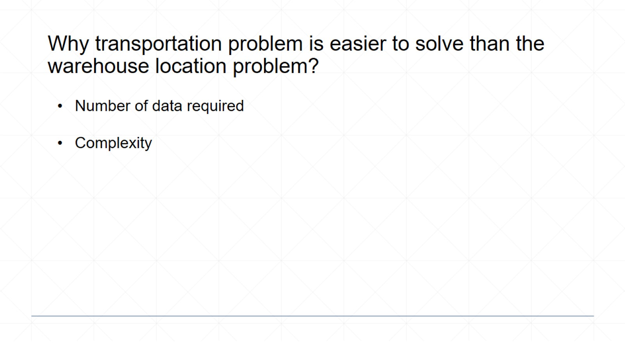
Why transportation problem is easier to solve than the warehouse location problem?

Slide 30
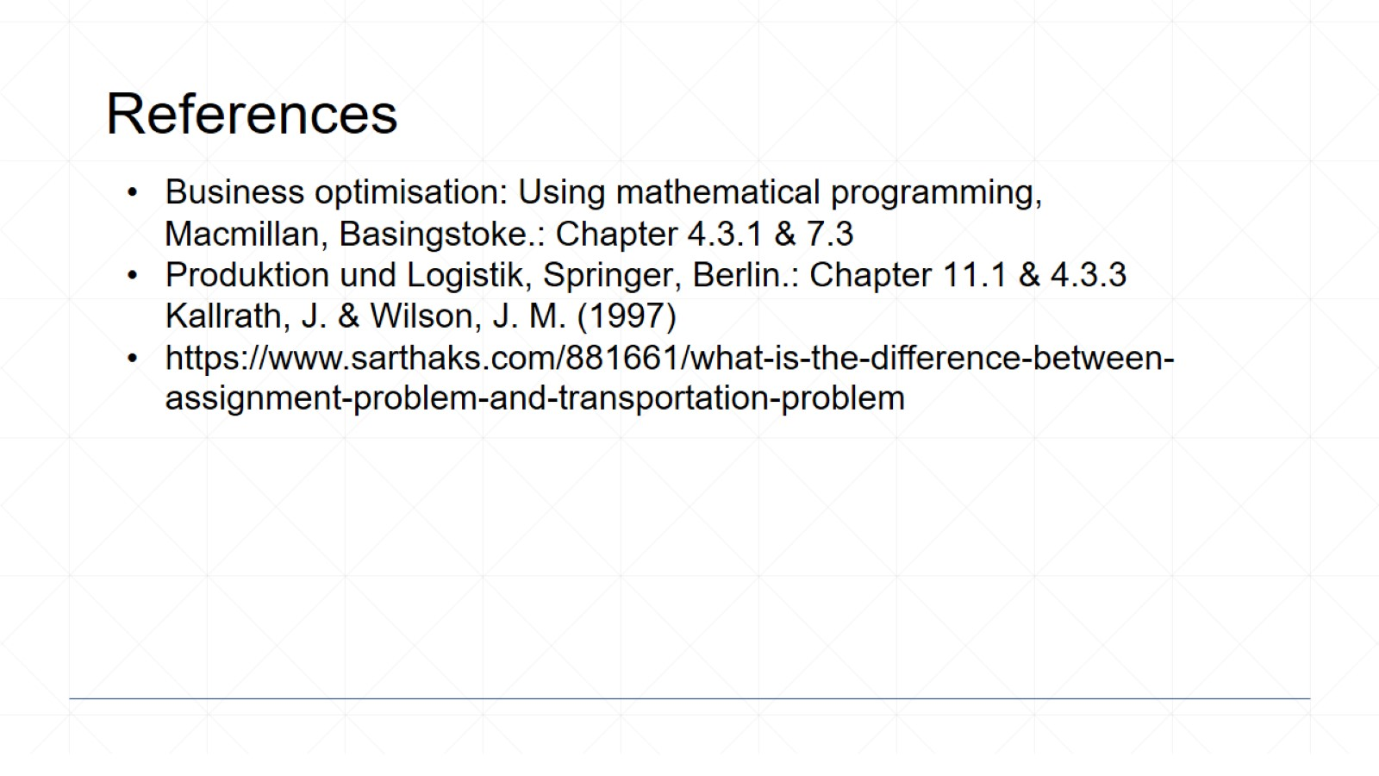
References

Slide 31
